Slide 1
TABLEAU PROJECT
THIS COMPLETE PROJECT IS ABOUT THE BIKE SALES IN EUROPE AND USING THIS DATA, CAME UP WITH THE VALUEABLE INSIGHTS IN A DASHBOARD
THIS COMPLETE DATA SET HAS 14 COLUMNS AND TOTAL 50027 ROWS
AND THE FIELDS OR TERMS WHICH THIS DATASET HAS ARE AS FOLLOWS:
YEAR, CUSTOMER AGE, AGE GROUP, CUSTOMER GENDER, COUNTRY, STATE,PRODUCT CATEGORY, SUB CATEGORY, PRODUCT, ORDER QUANTITY, UNIT COST, PROFIT, COST AND REVENUE.

Slide 2
PROBLEM STATEMENTS
YEAR VS REVENUE
COUNTEY VS REVENUE
GENDER VS REVENUE
AGE VS REVENUE
PRODUCT & YEAR VS PROFIT
ORDER QUANTITY & RROFIT VS COUNTRY
REVENUE & PROFIT VS YEAR
STATE VS ORDER QUANTITY

Slide 3
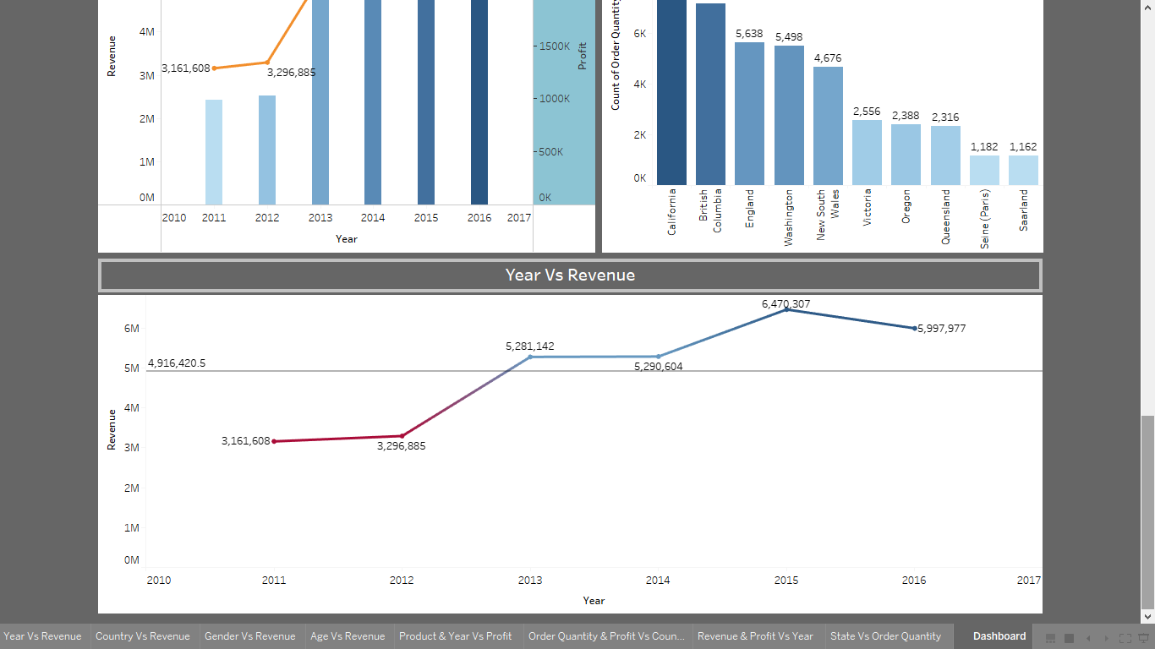
YEAR VS REVENUE

Slide 4
YEAR VS REVENUE - STORY
HIGHEST REVENUUE - 6,470,307
LOWEST REVENUE - 3,161,608
INSIGHTS:
FROM THE YEAR 2011 TO 2015 THE PROFIT WAS INCREASING BUT IN THE YEAR 2016 THE PROFIT DECREASED AS COMPARE TO THE PREVIOUS YEARS

Slide 5
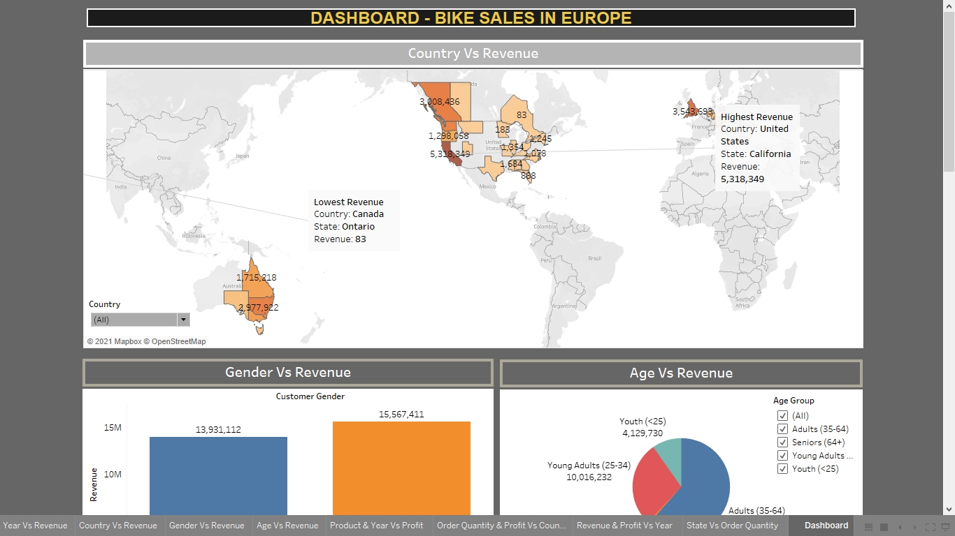
COUNTRY VS REVENUE

Slide 6
COUNTRY VS REVENUE
HIGHEST REVENUE COUNTRY - UNITED STATES (53,18,349)
LOWEST REVENUE COUNTRY – CANADA (83)
INSIGHTS:
IN THE UNITED STATES AND IN CALIFORNIA STATE THE REVENIE IS HIGH THAT IS 53,18,349
AND IN CANADA IN STATE ONTARIO THE REVENUW IS LOW AND IT IS 83

Slide 7
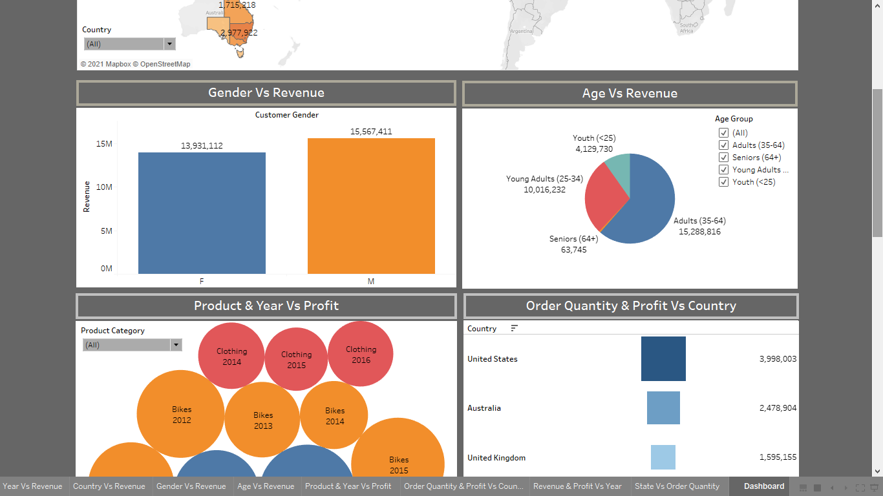
GENDER VS REVENUE
MALE REVENUE – 15,567,411
FEMALE REVENUE – 13,931,112

Slide 8
AGE VS REVENUE
HIGHEST REVENUE – ADULTS (35-64)
LOWEST REVENUE – SENIORS (64+)

Slide 9
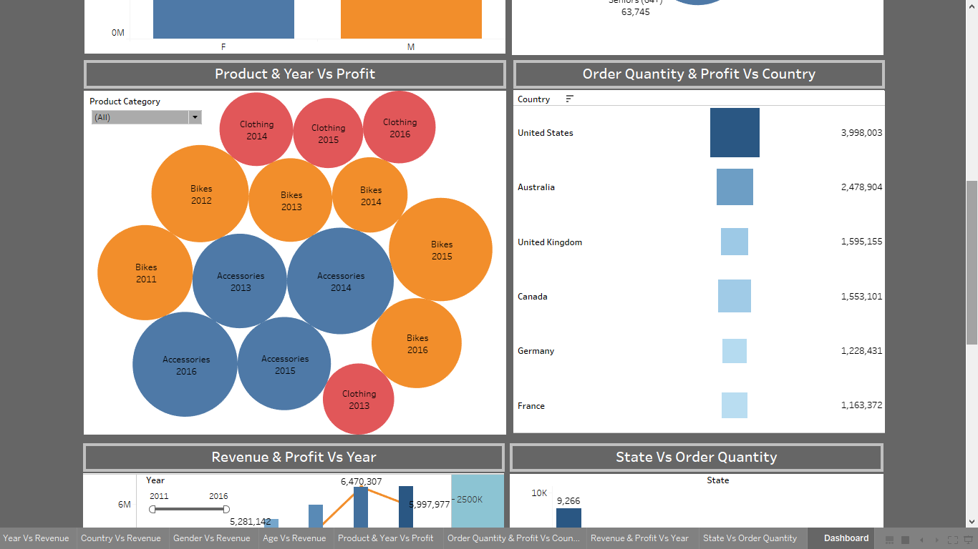
PRODUCT & YEAR VS PROFIT

Slide 10
PRODUCT & YEAR VS PROFIT - STORY
HIGHEST PRFIT - 2014 (ACCESSORIES)
LOWEST PROFIT – 2015 (CLOTHING)
INSIGHTS:
FOR ALMOST EVERY PRODUCTS THE PROFIT WAS FLUCTUATING IN EACH YEAR
IN THE YEAR 2015 THE PROFIT FOR ACCESSORIES WAS LOW AND THEN THE PROFIT INCREASED IN 2016
BUT FOR BIKE THE PROFIT WAS HIGH IN THE YEAR 2015 AND THEN IT DECREASED IN THE NEXT YEAR

Slide 11
ORDER QUANTITY & RROFIT VS COUNTRY

Slide 12
ORDER QUANTITY & RROFIT VS COUNTRY
HIGHEST ORDER QUANTITY & PROFIT – UNITED STATES
LOWEST ORDER QUANTITY & PROFIT - FRANCE
INSIGHTS:
IN THE UNITED KINGDOM THE ORDER QUANTITY WAS LOW BUT THE PROFIT WAS HIGH BUT IN THE CANADA THE QUANTITY WAS HIGH BUT THE PROFIT WAS LOW S COMPARE TO THE UNITED KINGDOM
AND THIS THING IS ALSO APPLICABLE FOR THE GERMANY AND FRANCE

Slide 13
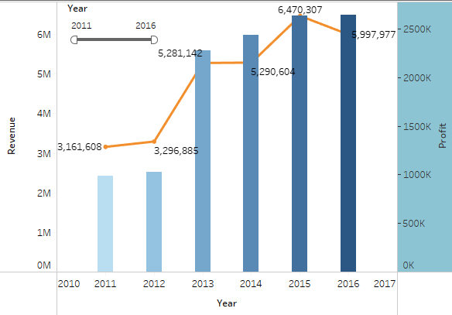
REVENUE & PROFIT VS YEAR

Slide 14
REVENUE & PROFIT VS YEAR
HIGHEST PROFIT & REVENUE – 2016
LOWEST PROFIT & REVENUE - 2011
INSIGHTS:
FROM THE YEAR 2011 TO 2014 PROFIT AND REVENUE WAS INCREASING BUT IN 2016 THE REVENUE DECREASED AS COMPARE TO THE YEAR 2015

Slide 15
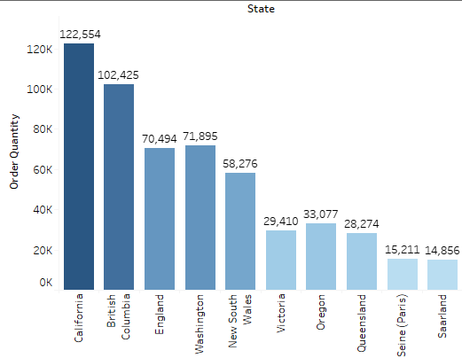
STATE VS ORDER QUANTITY
HIGHEST ORDER QUANTITY – CALIFORNIA (122,544)
LOWEST ORDER QUANTITY – SAARLAND (14,856)

Slide 16
CONCLUSION
YEAR VS REVENUE
HIGHEST REVENUUE - 6,470,307
LOWEST REVENUE - 3,161,608
COUNTRY VS REVENUE
HIGHEST REVENUE COUNTRY - UNITED STATES (53,18,349)
LOWEST REVENUE COUNTRY – CANADA (83)
GENDER VS REVENUE
MALE REVENUE – 15,567,411
FEMALE REVENUE – 13,931,112
AGE VS REVENUE
HIGHEST REVENUE – ADULTS (35-64)
LOWEST REVENUE – SENIORS (64+)

Slide 17
PRODUCT & YEAR VS PROFIT
HIGHEST PRFIT - 2014 (ACCESSORIES)
LOWEST PROFIT – 2015 (CLOTHING)
ORDER QUANTITY & RROFIT VS COUNTRY
HIGHEST ORDER QUANTITY & PROFIT – UNITED STATES
LOWEST ORDER QUANTITY & PROFIT - FRANCE
REVENUE & PROFIT VS YEAR
HIGHEST PROFIT & REVENUE – 2016
LOWEST PROFIT & REVENUE - 2011
STATE VS ORDER QUANTITY
HIGHEST ORDER QUANTITY – CALIFORNIA (122,544)
LOWEST ORDER QUANTITY – SAARLAND (14,856)

Slide 18
INTERACTIVE DASHBOARD

Slide 19
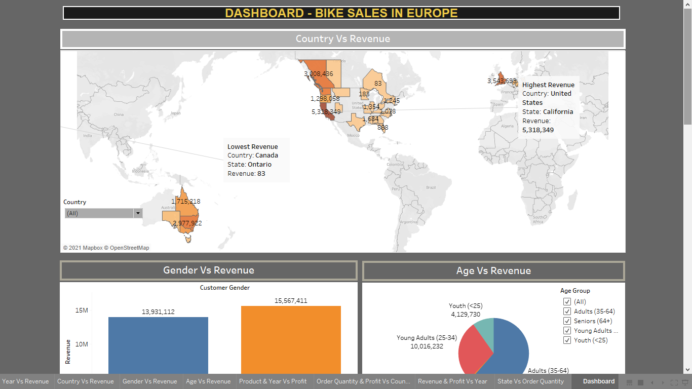

Slide 20
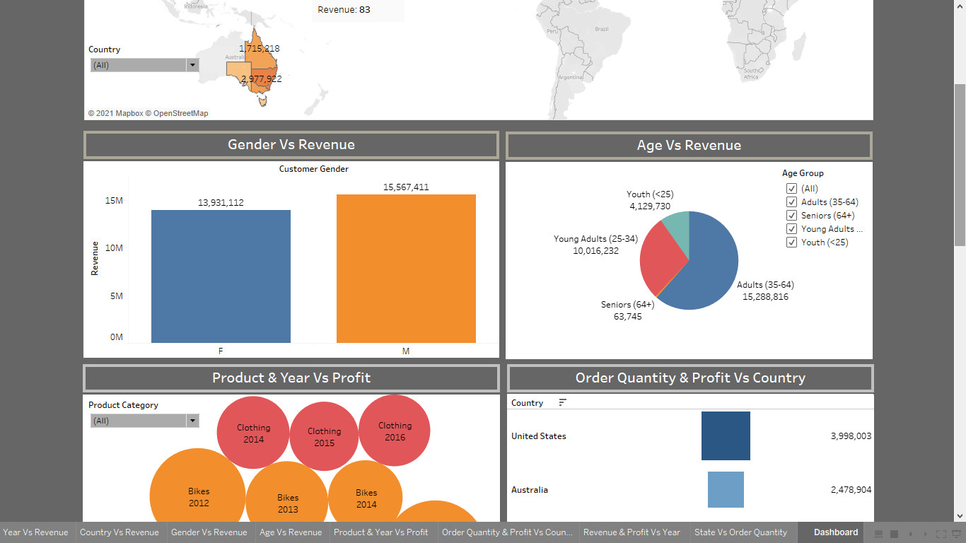

Slide 21
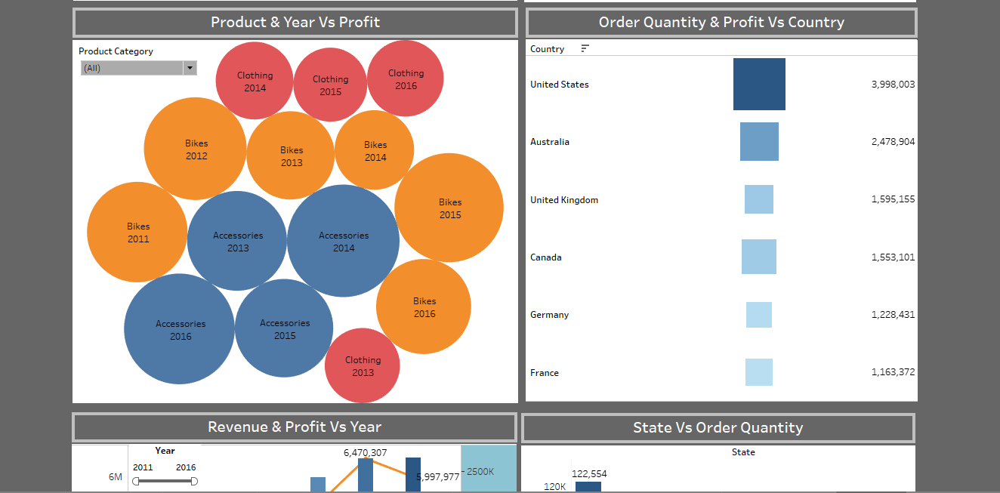

Slide 22
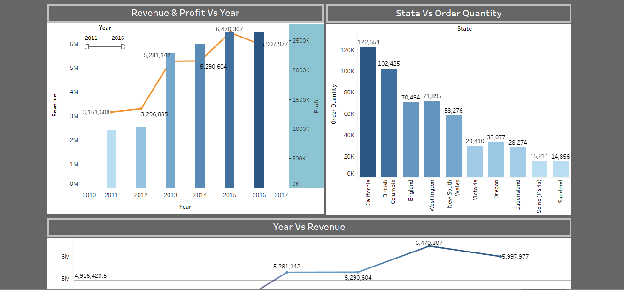

Slide 23


Slide 24
DATA SOURCE
DATA SET
https://www.kaggle.com/sadiqshah/bike-sales-in-europe
TABLEAU PUBLIC SOURCE
https://public.tableau.com/app/profile/aniket.kardile/viz/BikeSalesinEurope/Dashboard?publish=yes
VIDEO LINK
https://drive.google.com/file/d/1Gg3EO3V039cuuXpAR8jn9IWGatM_OfYO/view?usp=sharing

Slide 25
THANK YOU

